Slide 1
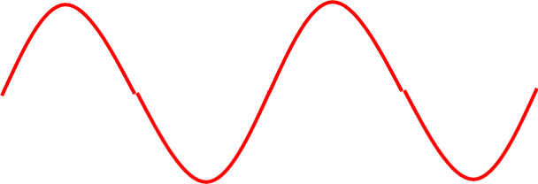
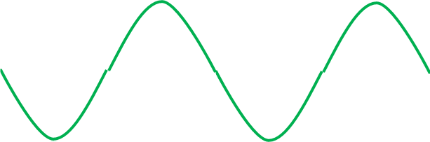
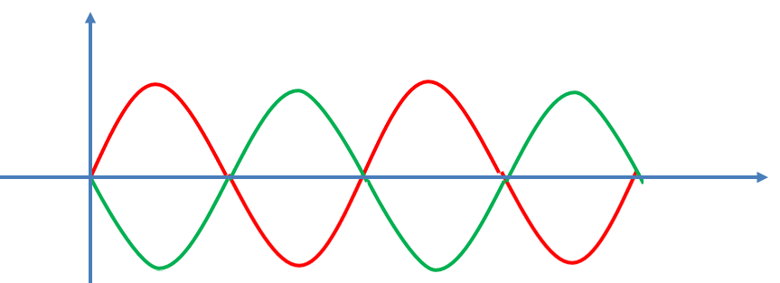
Standing Wave: If two sinusoidal waves of the same amplitude and wavelength travel in opposite directions along the same string then their interference will produce standing wave.
Y
Standing Wave
x

Slide 2
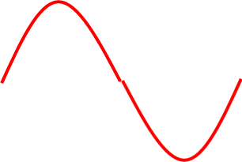
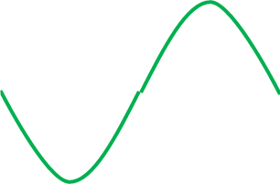
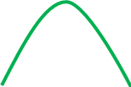
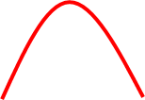




Equation of Standing Wave:
$$Y_{1}$$
$$Y_{2}$$
The equations of the individual waves,
$$Y_{1}\left(x,t\right)=Y_{m} Sin\left(kx−ωt\right)$$
$$Y_{2}\left(x,t\right)=Y_{m} Sin\left(kx+ωt\right)$$

Slide 3


So, the equation of the resultant standing wave,
$$Y\left(x,t\right)=Y_{1}(x,t)\text{+ }Y_{2}(x,t)$$
$${⇒Y\left(x,t\right)=Y}_{m} Sin\left(kx−ωt\right)+Y_{m} Sin\left(kx+ωt\right)$$
$${⇒Y\left(x,t\right)=Y}_{m} 2 Sin\frac{kx−ωt+kx+ωt}{2} Cos\frac{kx−ωt−kx−ωt}{2}$$
$${⇒Y\left(x,t\right)=2Y}_{m} Sin\left(kx\right) Cosωt$$
The amplitude of the standing wave,
$${A=2Y}_{m} Sin\left(kx\right)$$

Slide 4

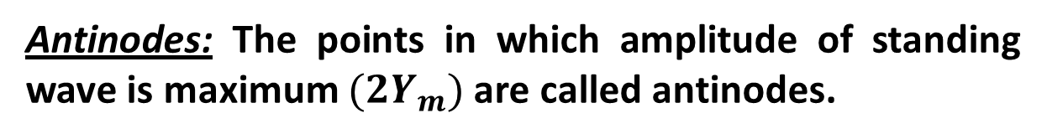
Node and Antinode:
Node
Antinode
Nodes: The points in which amplitude of standing wave is minimum (zero) are called nodes.
Antinodes: The points in which amplitude of standing wave is maximum ${(2Y}_{m})$ are called antinodes.

Slide 5

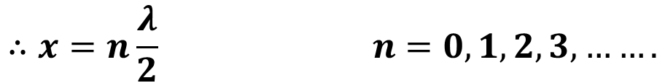


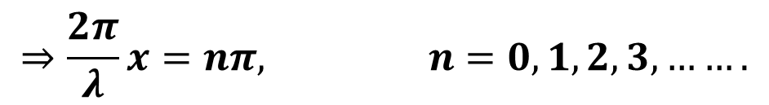






Position of Nodes:
$$n=0$$
We know, the amplitude for nodes,
$$n=1$$
$$n=2$$
$$A=0$$
$$⇒{2Y}_{m} Sin\left(kx\right)=0$$
$$⇒Sin\left(kx\right)=0$$
$$⇒Sin\left(kx\right)=Sin(0,π, 2π, 3π,………)$$
$$⇒kx=nπ$$
$$⇒\frac{2π}{λ}x=nπ, n=0,1,2,3,…….$$
$$∴x=n\frac{λ}{2} n=0,1,2,3,…….$$

Slide 6
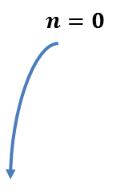
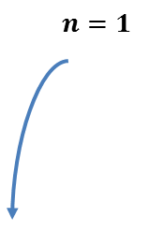
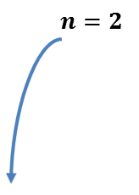
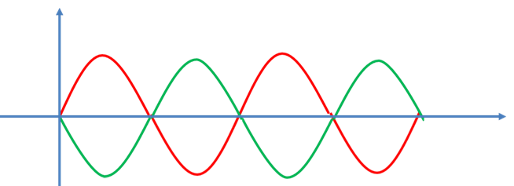
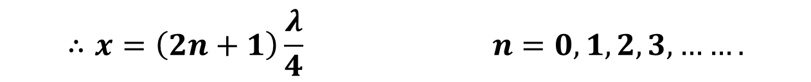

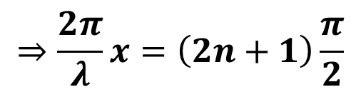

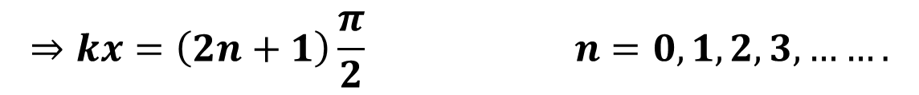
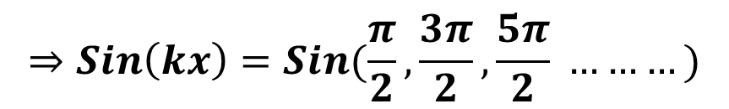

Position of Antinodes:
We know, the amplitude for antinodes,
$${A=2Y}_{m}$$
$$⇒{2Y}_{m} Sin\left(kx\right)= {2Y}_{m}$$
$$⇒Sin\left(kx\right)=1$$
$$⇒Sin\left(kx\right)=Sin(\frac{π}{2},\frac{3π}{2},\frac{5π}{2} ………)$$
$$⇒kx=\left(2n+1\right)\frac{π}{2} n=0,1,2,3,…….$$
$$⇒\frac{2π}{λ}x=\left(2n+1\right)\frac{π}{2}$$
$$∴x=\left(2n+1\right)\frac{λ}{4} n=0,1,2,3,…….$$

Slide 7

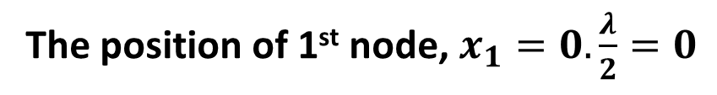
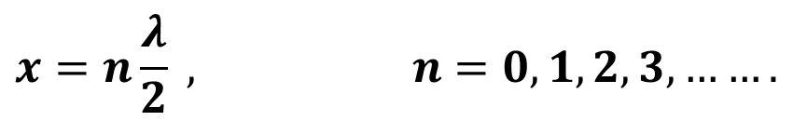
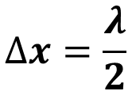
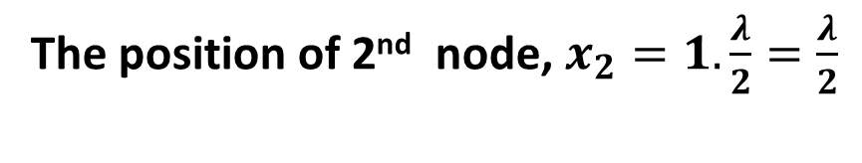
Distance between Adjacent Nodes:
The condition for the position of nodes,
$$x=n\frac{λ}{2} , n=0,1,2,3,…….$$
The position of 1st node, $x_{1}=0.\frac{λ}{2}=0$
The position of 2nd node, $x_{2}=1.\frac{λ}{2}=\frac{λ}{2}$
So, the distance between the nodes, $∆x=x_{2}−x_{1}$
$$∆x=\frac{λ}{2}$$

Slide 8
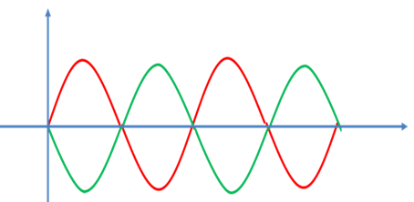
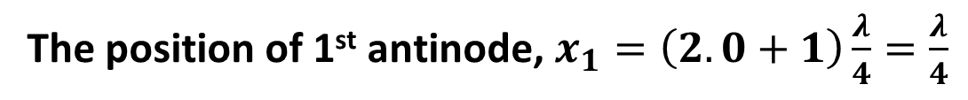
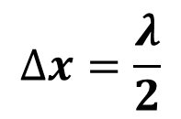
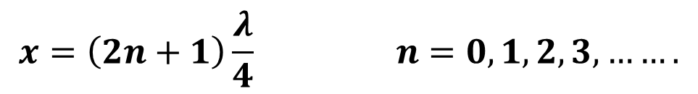
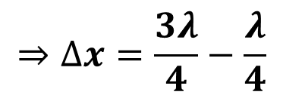
Distance between Adjacent Antiodes:
The condition for the position of antinodes,
$$x=\left(2n+1\right)\frac{λ}{4} n=0,1,2,3,…….$$
The position of 1st antinode, $x_{1}=\left(2.0+1\right)\frac{λ}{4}=\frac{λ}{4}$
The position of 2nd antinode, $x_{2}=\left(2.1+1\right)\frac{λ}{4}=\frac{3λ}{4}$
So, the distance between the antinodes, $∆x=x_{2}−x_{1}$
$$⇒∆x=\frac{3λ}{4}−\frac{λ}{4}$$
$$∆x=\frac{λ}{2}$$

Slide 9
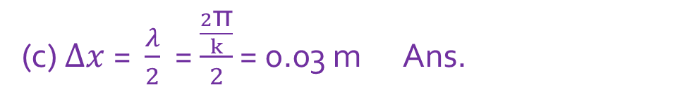
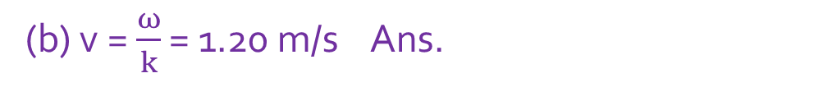
53. A string oscillate according to the equation
y′ = (0.50 cm) sin [(π/3 cm⁻¹)x] cos [(40π s⁻¹)t]. What are (a) the amplitude and (b) the speed of the two waves (identical except for direction of travel) whose superposition gives this oscillation? (c) What is the distance between nodes? (d) What is the speed of a particle of the string at the position x = 1.5 cm when t = 9/8 s?
(a) 2y_{m} = 0.50 cm
y_{m} = 0.0025 m Ans.
(b) v = $\frac{ω}{k}$ = 1.20 m/s Ans.
(c) $∆x$= $\frac{λ}{2}$ = $\frac{\frac{2\text{π}}{k}}{2}$ = 0.03 m Ans.

Slide 10
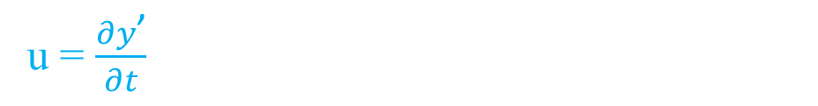
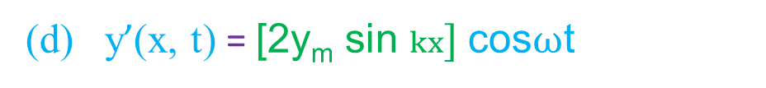
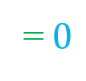
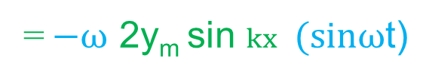
(d) y’(x, t) = [2y_{m} sin $kx] \text{cos}ω\text{t}$
u = $\frac{∂y\text{’}}{∂t}$
= $−ω$ 2y_{m} sin $kx \text{(}sinω\text{t}\text{)}$
= $−40$ $\text{π}$ 2(0.0025) sin {($\frac{\text{π}}{0.03})(0.015)\} sin \{40 \text{π}\text{(9/8}\text{)\}}$
= $0$

Slide 11
56. A standing wave pattern on a string is described by y(x,t)= 0.040 (sin 5πx)(cos 40πt), where x and y are in meters and t is in seconds. For x = 0, what is the location of the node with the (i) smallest, (ii) second smallest, and (iii) third smallest value of x?
For node, 0.04 Sin 5πx = 0
5πx = nπ
x = n/5
Smallest value, x= 0
Second smallest value, x= 1/5
Third smallest value, x= 2/5

